Slide 1


Major Project
Title:Handwriting Character Recognition
Presented by:
Mudit Dagar
BTech CSE AI & ML Batch- 4
500075764
R177219126
Mentored By:
Mr. Sudhanshu Srivastava
Assistant Professor
Department of Informatics
UPES, Dehradun
Prateek Sherawat
BTech CSE AI & ML Batch- 3
500075945
R177219073
Piyush Malviya
BTech CSE AI & ML Batch- 3
500075945
R177219073
Rahul Dhanola
BTech CSE AI & ML Batch- 3
500075154
R177219139

Slide 2
Content
Introduction
Literature Review
Objectives
Methodology
Working Model
Results
Conclusion
References

Slide 3
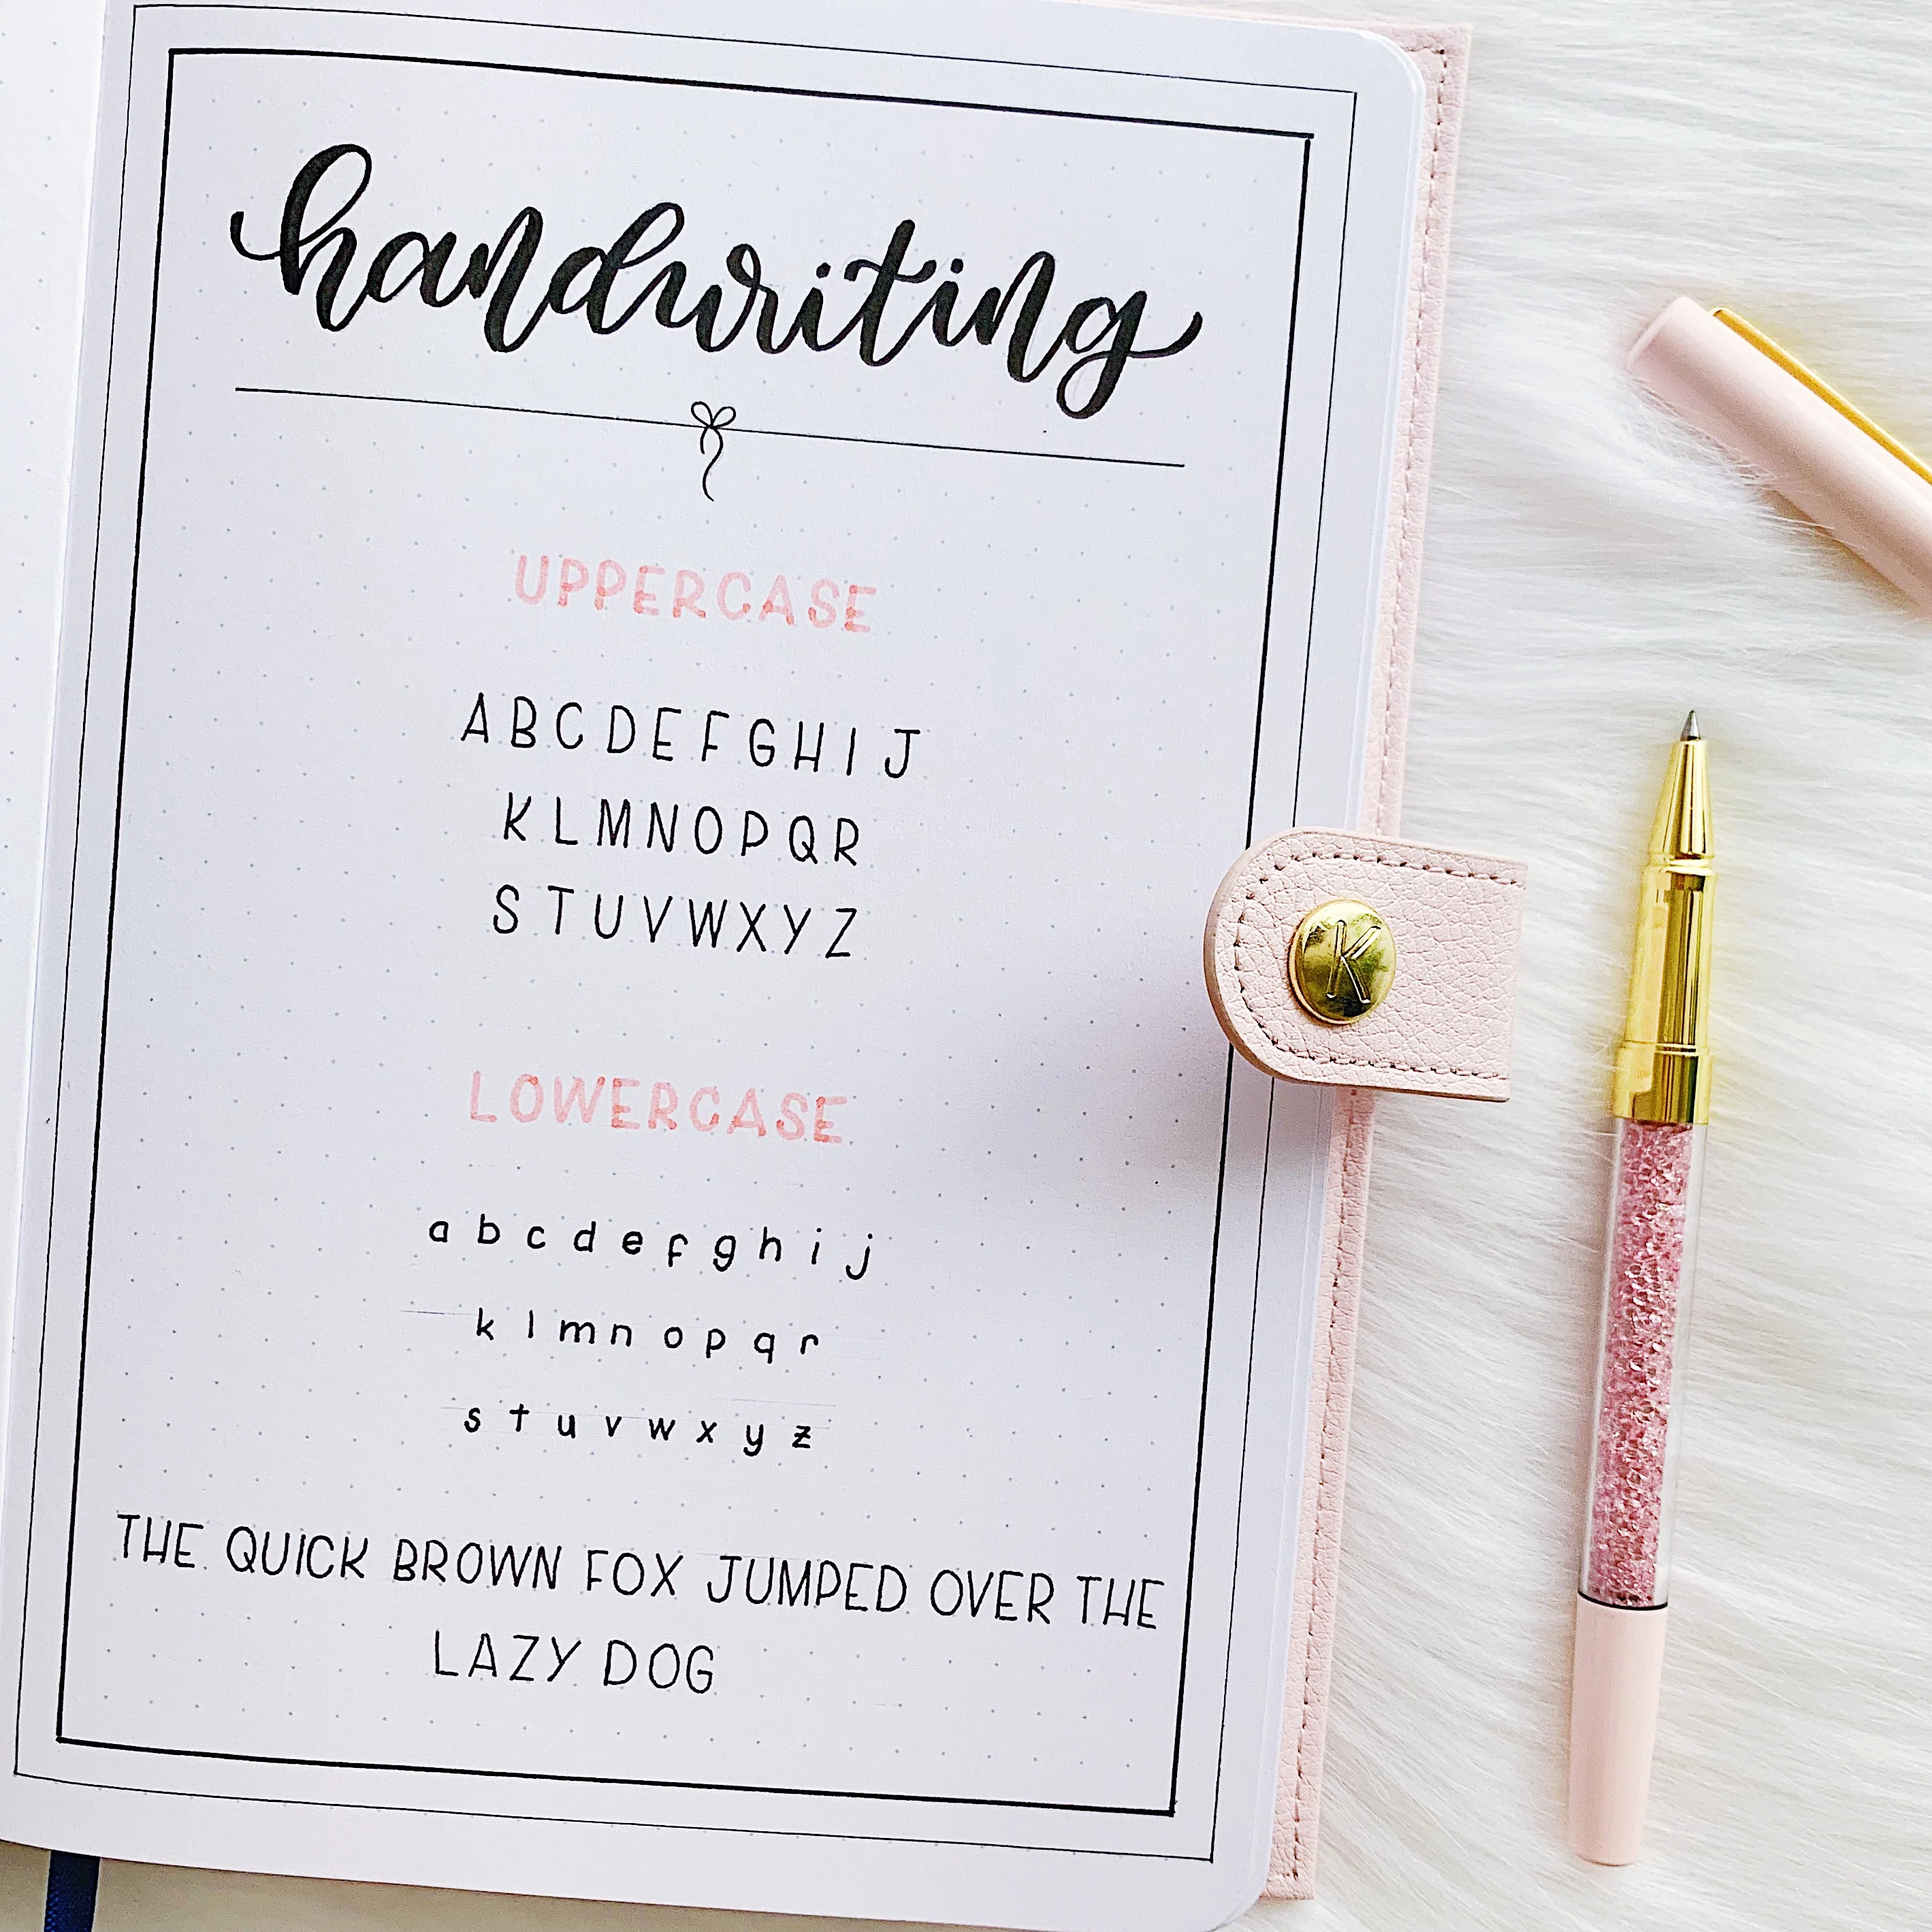
Introduction
Handwriting Character Recognition is a process that translates images of handwritten scanned text into machine-editable text, or pictures of characters into a standard encoding scheme representing them in ASCII or Unicode.
A Handwriting Character Recognition system enable us to feed a book or a magazine article directly into an electronic computer file, and edit the file using a word processor.
This project primarily focuses on recognition of a handwritten text from handwritten text images. It uses computer vision and machine learning. And it experiments with different approaches to the problem.

Slide 4
Literature Review
There is numerous literature and studies on the application of these algorithms to understand emotions and state of mind from human speech.
1. Intelligent Systems for Off-Line Handwritten Character Recognition: A Review
This paper provides a comparatively review of included works in handwritten character recognition based on soft computing technique.
2. An Overview of Character Recognition Focused on Off-Line Hand writing
In this paper forward-feed neural networks are used to processing of text for optical character.
3. Improving Offline Handwritten Text Recognition with Hybrid HMM/ANN Models
In this paper Hybrid Hidden Markov Model (HMM) is used for recognizing offline handwritten texts. In this paper, different techniques are applied to remove slope and slant from handwritten text and to normalize the size of text images with supervised learning methods. The key features of this recognition system were to develop a system having high accuracy in preprocessing and recognition, which are both based on ANNs.

Slide 5
Problem Statement
The main problem is the handwriting style of every different people has its own approach to handwriting in different languages .This problem motivated us to build a system that will recognize character (English) given as an input image.
Handwriting Character Recognition (HCR) is using the stages like preprocessing, segmentation, feature extraction and recognition using neural network.
In Preprocessing image document to make use for segmentation. In segmentation the image is segmented into individual character then feature extraction technique is apply on character image.

Slide 6
Objective
To develop a Handwriting Character Recognition system using the Convolutional Recurrent Neural Networks (CRNN) and its accuracy will be tested using Machine Learning metrices and Label Error Rate.
Therefore, the following objectives need to be achieved to satisfy the development of the project.
To study Convolutional Recurrent Neural Network (CRNN) algorithm and develop a system that is able to recognize characters
To detect, extract and recognize characters using Convolutional Recurrent Neural Network (CRNN).
To reduce noise from handwritten documents.

Slide 7
Dataset
We are using four handwritten datasets for the recognition of handwritten text. All together it should total in about 188000 images.
IAM Handwriting Data [85000 images] : The IAM Handwriting Database contains forms of handwritten English text and was first published in at the ICDAR (International Conference on Document Analysis and Recognition) 1999.
CVL Database: The CVL Database is a public database for writer retrieval, writer identification and word spotting. The database consists of 7 different handwritten texts.
ORAND CAR 2014: The ORAND-CAR-2014 dataset consists of approximately 10,000 CAR* images extracted from real bank checks with a resolution of 200 dpi. The dataset contains approximately 5000 images for training purposes and 5000 images for testing.
Google Drive Data [5000 images] : The Datasets are collected by various other sources and merges in a single zip file stored at Gdrive.
* Note: CAR is an abbreviation for Courtesy Amount Recognition, a technique used in the electronic check clearing process to determine the value of the check.

Slide 8
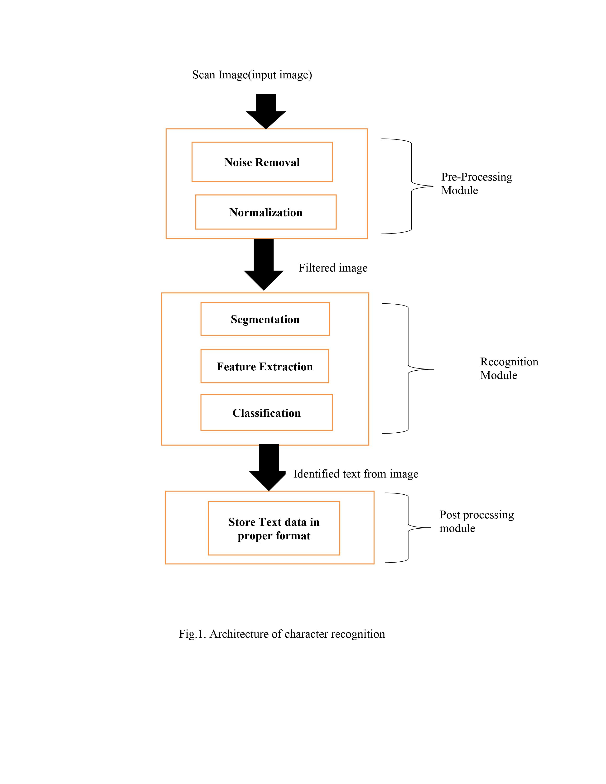
Model Architecture

Slide 9
Preprocessing
We have done preprocessing of data in 3 steps:
We have extracted image files and arranged them in their respective datasets folder.
We normalize the images and transformed them into black and white format i.e. binarizing for getting a clear contrast of the text written.
Now we have created a csv file containing the paths to the normalized images and there corresponding label names, which will be divided into train, test and validation datasets.

Slide 10
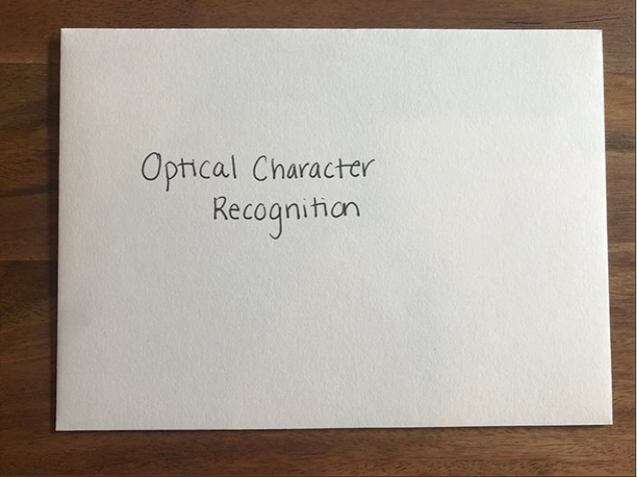
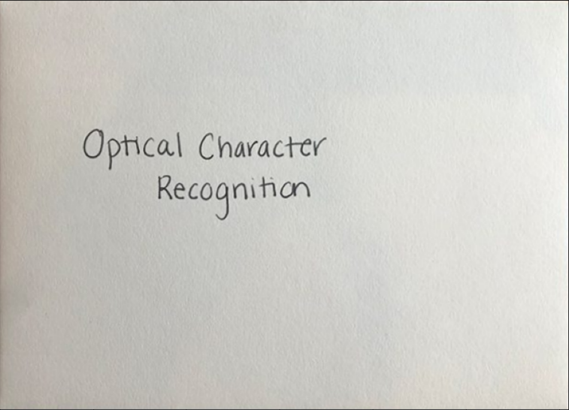
Background Removal:
First The Background of an input image is removed.
Input Handwritten Text
Processed Handwritten Text after Background Removal
Notes:
MFCC is used to produce the coefficients that describe the frequency Cepstral; these coefficients are based on the linear cosine transform of the log power spectrum on the nonlinear Mel scale frequency.

Slide 11
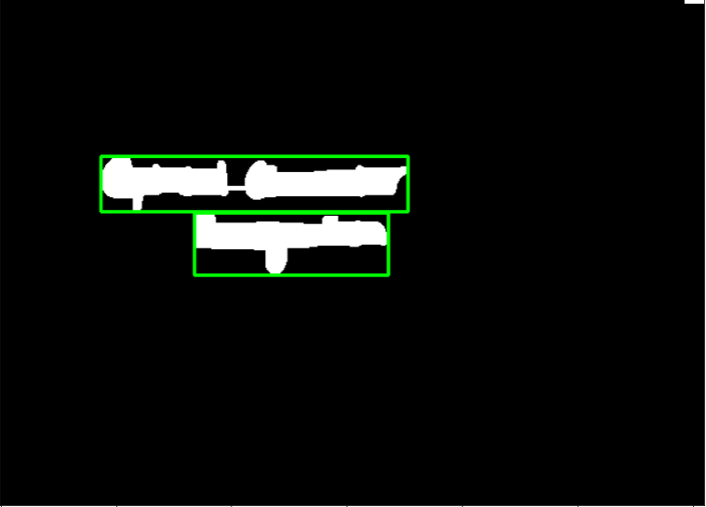
Words Detection And Normalization:
After that image is Normalized by help of Binarization i.e. convert to Black & White Format and then we use OpenCV to make Bounding box across white region.

Slide 12

Prediction By Model of the Text:
The Image is then Predicted by the Model.
Optical Character Recognition

Slide 13
Methodology
Feature Extraction using the Image processing libraries
Creating a Connectionist Temporal Classification (CTC) Model
Load the Image Datasets
Text recognized
Training the Model

Slide 14
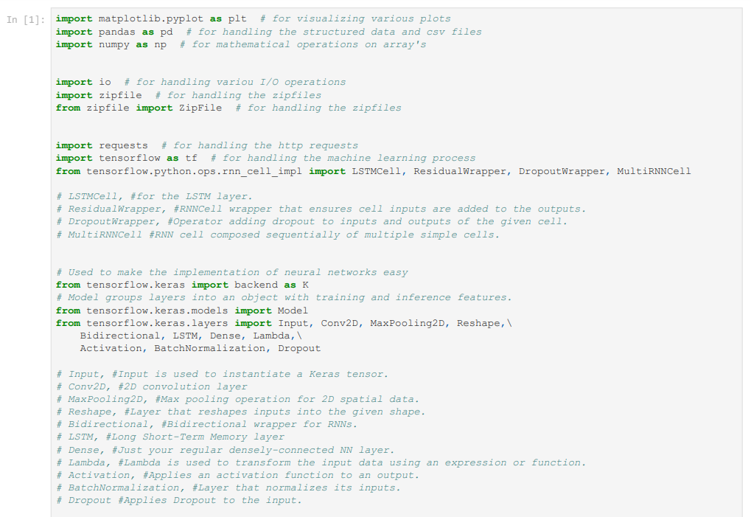
Python Libraries Used:

Slide 15
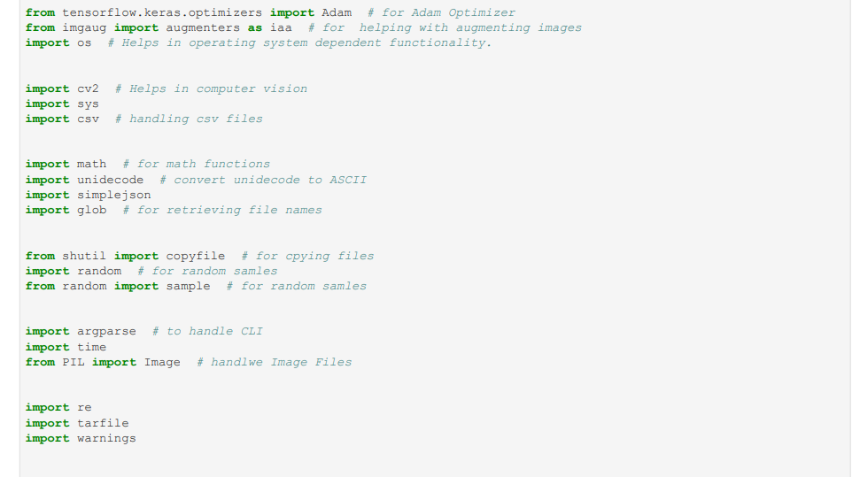
Python Libraries Used:

Slide 16
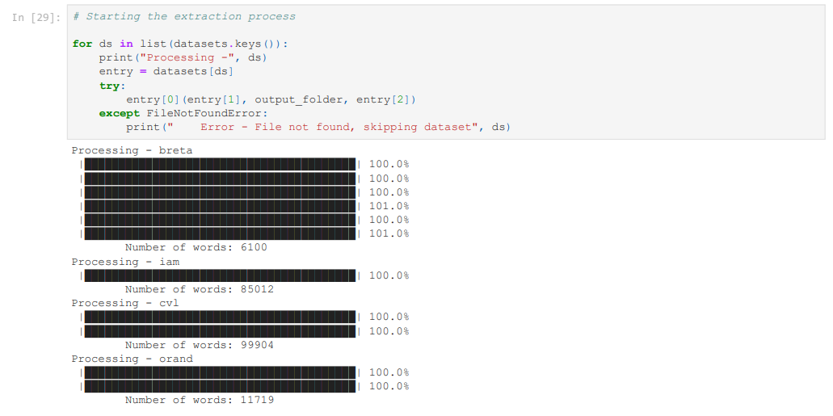
Count of Handwritten Images in dataset:

Slide 17
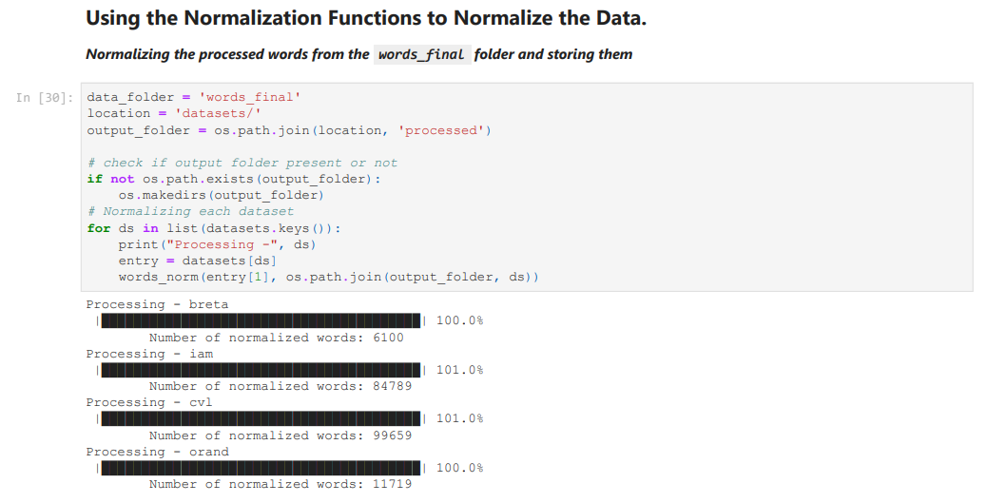
Normalization of the Data:

Slide 18
Timeline
Our month wise plan to complete the project is as follows
August
Finalizing the dataset.
Research on Speech Analysing techniques.
Deciding the architecture of the model.
September- October
Developing the architecture
Training the model.
Debugging the code.
Retraining the model to increase accuracy of model.
November
Concluding the result
Publishing the results.
Submitting the project.

Slide 19
References
Shabana Mehfuz,Gauri katiyar, ‘Intelligent Systems for Off-Line Handwritten Character Recognition: A Review” ,International Journal of Emerging Technology and Advanced Engineering Volume 2, Issue 4, April 2012. Access Date: 09/07/2015.
]Rahul KALA, Harsh VAZIRANI, Anupam SHUKLA and Ritu TIWARI, “An Overview of Character Recognition Focused on Off-Line Handwriting”, IEEE TRANSACTIONS ON SYSTEMS, MAN, AND CYBERNETICS PART APPLICATIONS AND RE- VIEWS, VOL. 31, NO. 2, MAY 2001. Access Date:09/07/2015
]Miroslav NOHAJ, Rudolf JAKA, “Image preprocessing for optical character recog- nition using neural networks ”Journal of Patter Recognition Research, 2011. Access Date:09/07/2015.
]Nisha Sharma et al, “Recognition for handwritten English letters: A Re- view “International Journal of Engineering and Innovative Technology (IJEIT) Volume 2, Issue 7, January 2013. Access Date:09/07/2015
Salvador España-Boquera, Maria J. C. B., Jorge G. M. and Francisco Z. M., “Improving Offline Handwritten Text Recognition with Hybrid HMM/ANN Models”, IEEE Transactions on Pattern Analysis and Machine Intelligence, Vol. 33, No. 4, April 2011

Slide 20
Thank You

